Slide 1
Software Testing
Code-Based, Unit, Path Testing
(Or, Structure-Based, Unit, Control Flow Testing)
Presented By
Ning Chen, Ph.D.
Professor
Department of Computer
Science
California State University,
Fullerton
© Ning Chen, 2017
*

Slide 2
Module Objectives
This module focuses on the Code-Based, Unit, Path Testing
(Or, Structure-Based, Unit, Control Flow Testing).

Slide 3
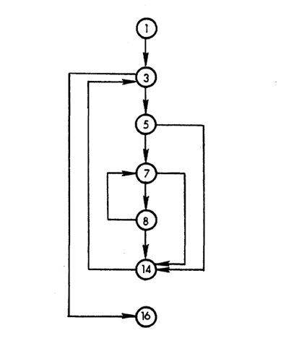
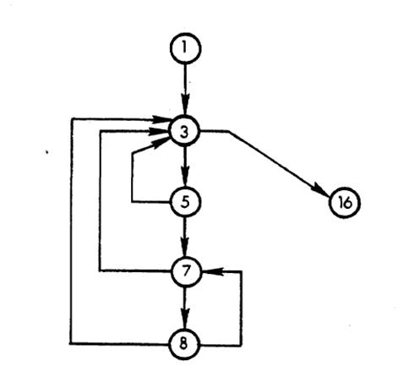
Decision Graph

Slide 4
How?
If you examine the segment graph, you may observe that some nodes are decision nodes that are related to decision making. For example, node 3 offers two outward edges – one goes to node 5 and the other goes to node 16. By inspection we have the following decision nodes: nodes 3, 5, 7 and 8. If you consider the entry node and exit node are decision node (although they don’t have multiple outgoing edges, they do represent entry decision or exit decision in some way), our decision nodes now are: node 1, 3, 5, 7, 8 and 16. The only non-decision node is node 14.

Slide 5
How?
If we hide the non-decision nodes in the segment graph we discussed, we will end up with another level of abstracted graph, called Decision Graph (or Decision Path Graph, DD-path Graph) as follows:

Slide 6
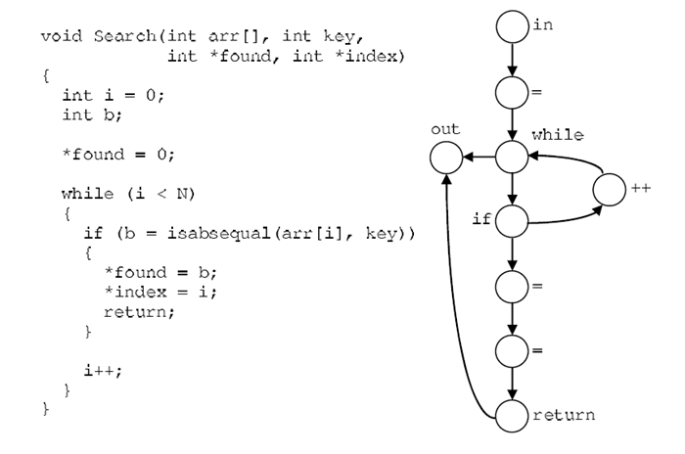
Observation (one more time)
Since in our top-down approach we totally rely on our observation and intuition, seeing another example maybe is helpful. We found another example from [Robert Gold, 2010] as follows:

Slide 7
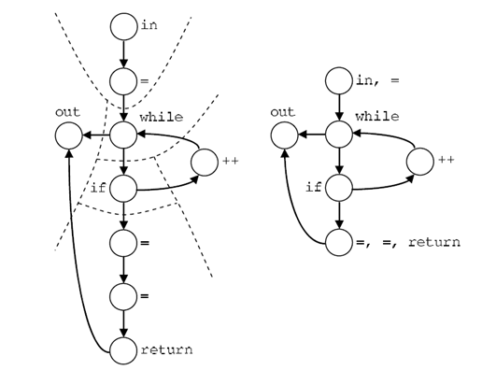
Segment Graph

Slide 8
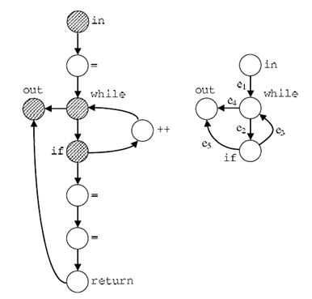
Decision Graph
The next step is to abstract further and obtain a decision graph as below:

Slide 9
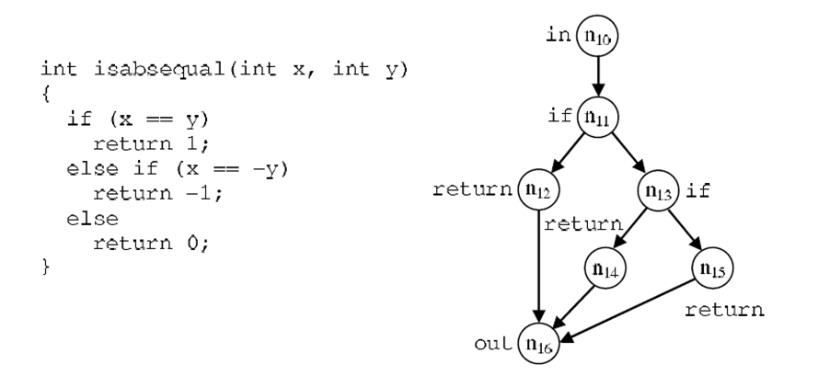
Are we done? (not yet)
The Search function comes with a subroutine. We may want to analyze it as follows:

Slide 10
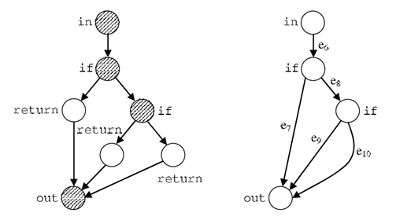
Decision Graph

Slide 11
Why?
After seeing those two examples, do we know how to reduce a program graph to a segment graph and then, to a decision graph? Well, sort of, but not exactly. We really are not so sure our simple common sense observation applies to all possible cases. At this point, our urgent job is not trying to prove something (in fact, someone has done it already). Our urgent task actually is to understand what benefits the abstracted graphs (segment graph and decision graph) can bring to us.

Slide 12
Need Further Observations
An example from [Robert Gold, 2010] gives us some good clues.

Slide 13
Careful Observation
Let’s say we need to test the program p that consists of the functions Search and isabsequal.

Slide 14
Test Case #1
Test case #1:
  input arr == {1, 2, 3, 4},
  key == -3
We will cover the following decision graph edges:
  e1 e2 e3 e2 e3 e2 e5
  e6 e8 e10
  e6 e8 e9

Slide 15




Very Tedious Work (but can be automated)

Slide 16
Test Case #2
Test case #2
  input arr == {1, 2, 3, 4},
  key == 3
Test case #2 passes a new edge:
  e6 e7

Slide 17
Test Case #3
Test case #3
  arr == {1, 2, 3, 4},
  key == 0,
a new path e1 e2 e3 e2 e3 e2 e3 e2 e3 e4 is executed.
At this point, all edges of the decision graphs are covered.

Slide 18
Interesting Insights
If your test cases cover all the edges of a decision graph, what have you achieved? Well, if you realize that an edge of a decision node (NOT the node itself) represents a branch of the program. If your test cases cover all the edges of the decision graph, you have tested all the branches of your program.

Slide 19
Tricky Question
One subtle and tricky (but important) question is that if you cover all the nodes of the decision graph (NOT all the edges of the decision graph), can you claim that you cover all the statements of a given program?
The above test cases actually reveal the answer (the answer is no). If you only use Test case #1 and Test case #3 (do not use Test case #2), you still cover (or traverse) all the nodes of the decision graph. It is obviously that without using Test case #2, you will never cover the node 12 of the program graph.

Slide 20
Conclusions
1. Given a program, you can find its program graph.
2. When you run a test case through the program graph, you know what nodes of the program graph have been traversed.
3. If your test cases that collectively traverse all nodes of the program graph, you can say that your test cases produce 100% statement coverage.

Slide 21
Conclusions
1. Given a program graph you can find its decision graph.
2. When you run a test case through the program’s decision graph, you know what edges of the decision graph have been traversed.
3. If your test cases that collectively traverse all edges of the decision graph, you can say that your test cases produce 100% branch coverage.

Slide 22
Why?
Q. Why do we develop the concept and mechanism of the Decision Graph?
A. Once we have the mechanism, we can write a software tool that monitors the execution of test cases and tells us the percentage of the Branch Coverage.

Slide 23
Tricky Question
As a test manager, do I prefer (if I have a chance) 100% statement coverage or 100% branch coverage?

